Slide 1
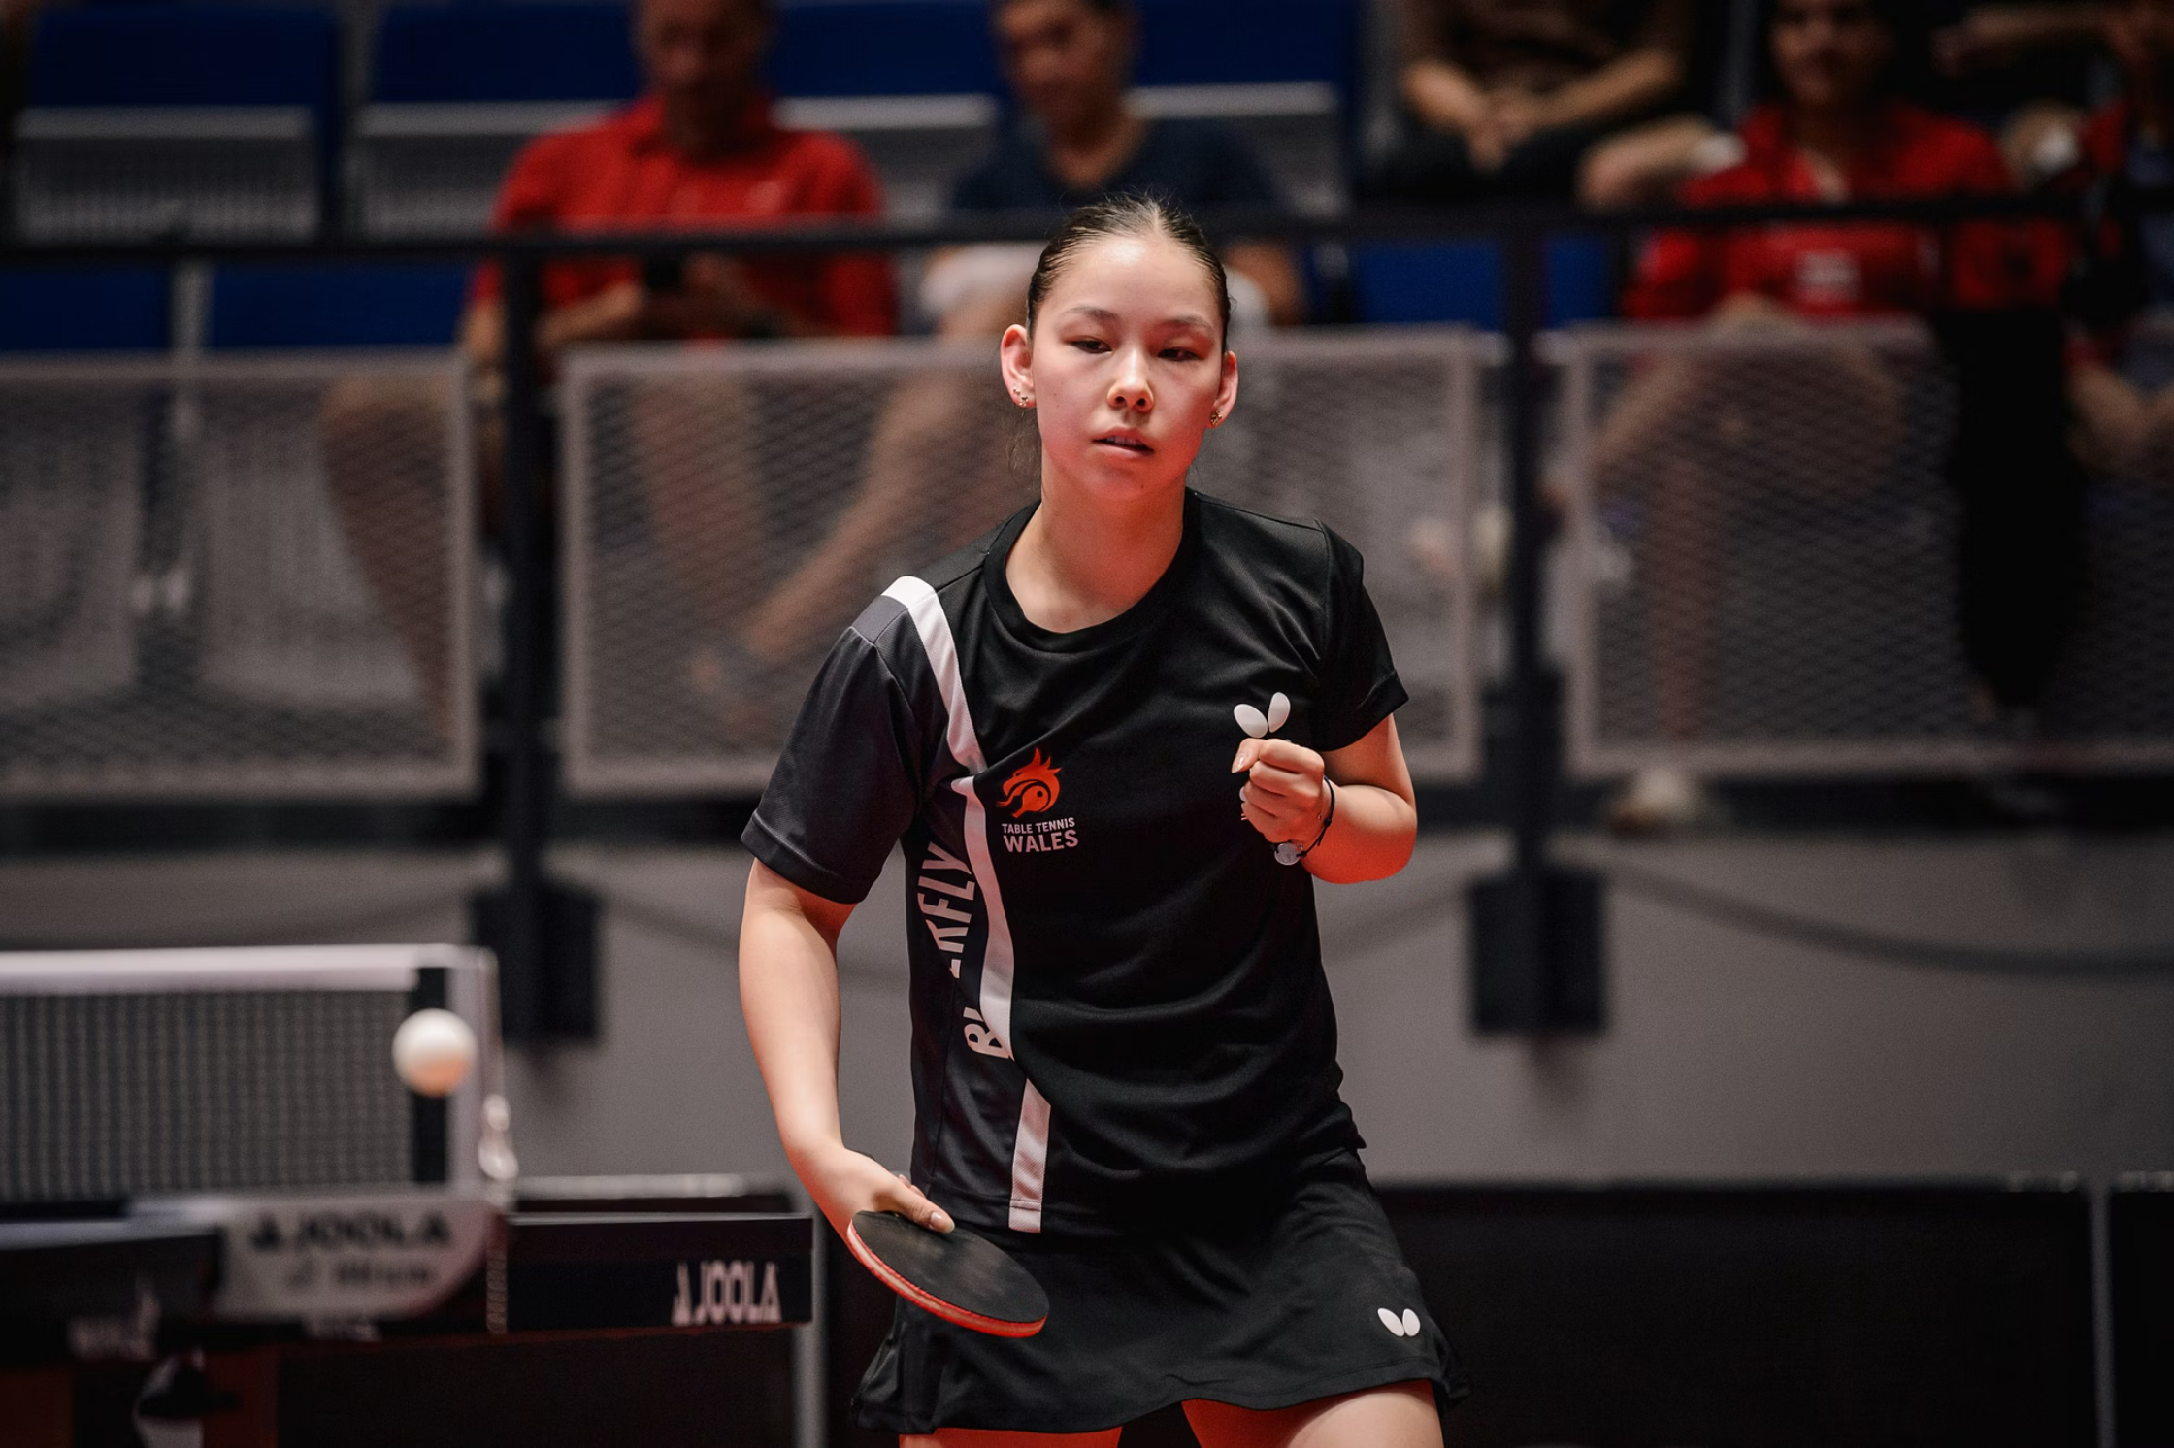
Director of Finance - Appointed Board Director
Shaping the Financial Future of Table Tennis Wales

Slide 2
Interview Presentation Ideas
Candidates may be asked to deliver a short presentation as part of the interview process. Here are suggested presentation topics that align with the Director of Finance NED role:
01
02
My Vision for Financial Sustainability at Table Tennis Wales (2026-2029)
Building a Culture of Financial Governance and Accountability
Present a strategic financial roadmap for ensuring long-term sustainability and growth over the next three years.
Outline how you would strengthen financial controls, transparency, and accountability across the organisation.
03
04
Diversifying Revenue Streams for Table Tennis Wales
Financial Planning and Risk Management in a Sporting NGB
Develop a plan for identifying and growing new income sources including grants, sponsorship, and commercial opportunities.
Propose a framework for robust budgeting, forecasting, and financial risk management.
05
06
Engaging Stakeholders in Financial Strategy
Financial Metrics That Matter
Demonstrate how you would communicate financial performance and strategy to members, Sport Wales, and other key partners.
Present a framework for measuring financial health with clear KPIs, reporting standards, and evaluation methods.

Slide 3
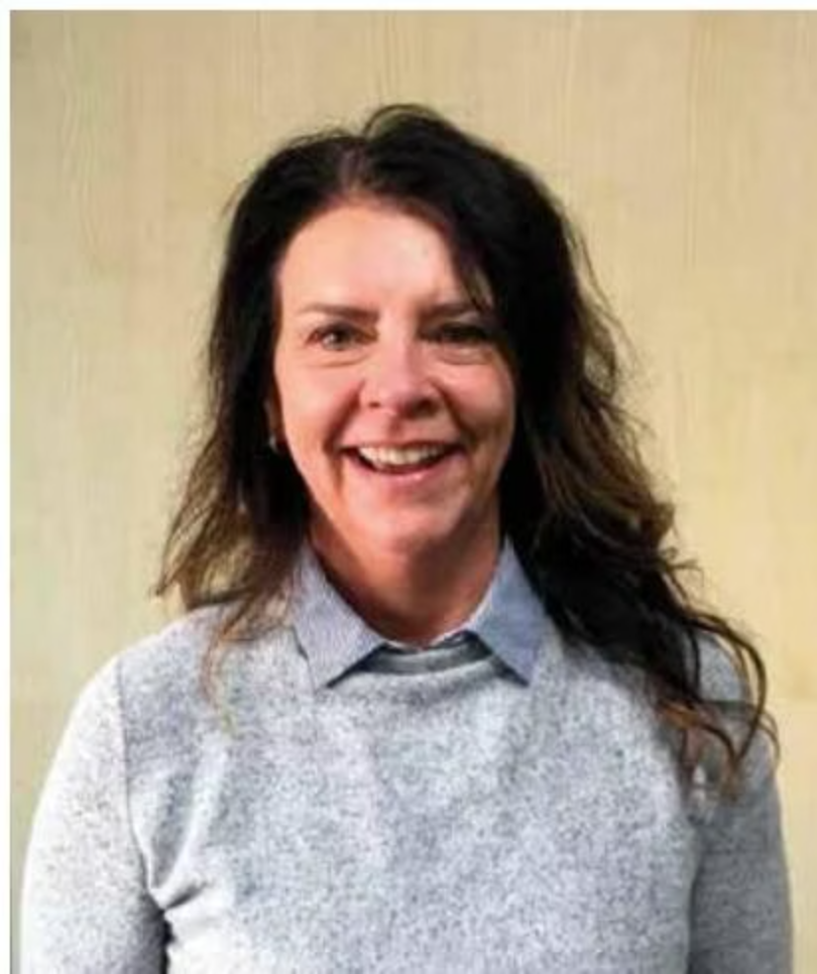
Welcome
Thank you for your interest in becoming an Appointed Director (Finance) for Table Tennis Wales.
We are embarking on a pivotal journey of growth and transformation, building a dynamic Board fully committed to realising our ambitious vision and mission. Our new strategy will harness collective financial expertise and collaborative leadership to ensure the long-term sustainability and success of Table Tennis throughout Wales.
This pack provides comprehensive details about the Director of Finance role and our expectations for this vital leadership position. We welcome any questions you may have.
Nicki Arthur
Chair, Table Tennis Wales

Slide 4
About Us
The Table Tennis Association of Wales or Table Tennis Wales, as it's better known is the not-for-profit official national governing body, responsible for both the grassroots growth of the sport and the development of Wales' Commonwealth and Olympic Games elite athletes.
Board Structure
Our Responsibility
Our Focus
The Board comprises 10 Directors; the Chair, Chief Executive, three Elected Directors, and seven appointed Directors.
The Board is responsible for managing the business of Table Tennis Wales, working collaboratively with our Members and the wider table tennis family, and a broad range of partners, including Sport Wales.
Our business focuses primarily on providing services to our members, strategy, governance, finance, risk, stakeholders, and the oversight of the executive team which is led by the Chief Executive.
There are several Advisory Committees to the Board, and all Directors are expected to sit on at least one Advisory Committee depending on their skills and experience. For this role it is the Finance Committee.

Slide 5
Strengthening Our Board
Table Tennis Wales is seeking to strengthen its Board with an exceptional individual who wish to serve as a Non-Executive Director and support the direction for the next phase of the organisation's development.
The successful candidate will have a passion for success and demonstrate a strong commitment to the delivery of excellence and quality.
As a national governing body of sport, it is important that Table Tennis Wales has a diverse board and that each Appointed Director brings a range of skills, knowledge and experience from different backgrounds that complements the board.

Slide 6
The Role: Director of Finance
Skills, Knowledge and Experience
Director of Finance
The successful Director would need to have experience in the following key areas:
Financial Leadership & Strategy
Governance & Compliance
Stakeholder & Funder Engagement
Understanding of financial governance, audit, and risk management frameworks
Experience working with or serving on Finance Committees or Audit & Risk Committees
Experience in financial planning, budgeting, and long-term financial strategy
Knowledge of financial sustainability and reserves management in the charity/not-for-profit sector
Knowledge of grant funding, including Sport Wales or public sector funding
Experience engaging with external auditors, funders, and financial stakeholders

Slide 7
What You Will Demonstrate
Time and Commitment
Time to support the growth and success of table tennis in Wales.
Independent Thinking
Independence of thought and impartiality.
Board Knowledge
A knowledge of the responsibilities of a member of a Board.
Team Player
A collaborative team player.
Interpersonal Skills
Excellent interpersonal skills, including the ability to work effectively within the Board.

Slide 8
Time Commitment and Terms
Time and Commitment
Term of Office
Board meetings take place six times per year, which are usually held at Sport Wales.
The appointment is for a three-year term from the date of appointment. One further three-year term can be served.
The Director of Finance will lead the Finance Sub Committee.
The role is voluntary, and we will pay Directors' travel expenses and provide a full induction to the organisation's work.

Slide 9

How To Apply
Your Application
An up-to-date CV and a covering letter which details your skills and experience in relation to the role description and importantly your Table Tennis experience. Please could you outline how you meet the requirements of the role, and why it appeals to you.
Closing Date: 30th April 2026
Please email your application to the Chair:
chair@tabletennis.wales
The 2026 Recruitment Process
You will receive an acknowledgement to your email to confirm your application has been received.
All candidates' CVs and Covering letters will be considered and a recommendation made to the Board of Directors.
For more detailed information about Table Tennis Wales, and a list of the current Directors, please visit https://tabletennis.wales
For an informal discussion about the role of a Director please contact.
Nicki Arthur: chair@tabletennis.wales

