Slide 1
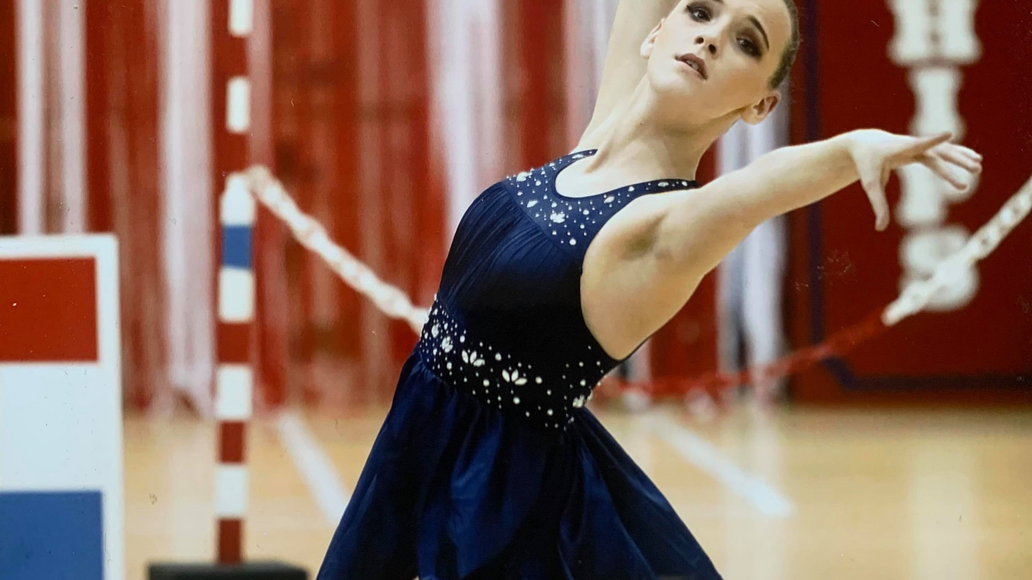

BTAC Roadmap to training
Phase | Personal Skills | Group Outdoor training | Inside Training | Full Training | Full Competition
Stage | Individual Activity Video Call training App | Co-ordinated Group outdoor training | Socially Distanced Indoor training | Full training, with teams, pairs. | Return to the competition hall
Considerations | Lockdown in place, training individually. Using the App, video training with coaching team | Social Distancing No Equipment Sharing Organised Club/NGB Training Outdoors Coach Led Groups no larger than 30 inc coaches | Social Distancing No Equipment Sharing Organised Club/NGB Training Coach Led Smaller groups | Full team training Welsh squad training International preparation Exchanges and other equipment sharing Close Contact | Return to local, national and international competitions Spectators allowed
Date | 20th March – 12th July | 13th July ------ | 10th August | TBC | TBC
GOVERNMENT GUIDANCE REQUIREMENTS | Only allowed out with members of your own household Avoid unncessary travel | Group organised activity allowed to take place with up to 30 people Social Distancing Parks reopened | Ability to train indoors | Removal of Social Distancing Uncapped number of people allowed to meet indoors | Approval of mass gatherings

